Slide 1

JavaScript, Sixth Edition
Chapter 5
Working with the Document Object Model (DOM) and DHTML

Slide 2
Objectives
When you complete this chapter, you will be able to:
Access elements by id, tag name, class, name, or selector
Access element content, CSS properties, and attributes
Add and remove document nodes
Create and close new browser tabs and windows with an app
JavaScript, Sixth Edition

Slide 3
Objectives (cont'd.)
When you complete this chapter, you will be able to:
Use the setTimeout() and setInterval() methods to specify a delay or a duration
Use the History, Location, Navigation, and Screen objects to manipulate the browser window
JavaScript, Sixth Edition

Slide 4
Understanding the Browser Object Model and the Document Object Model
JavaScript treats web page content as set of related components
  objects
Every element on web page is an object
You can also create objects
  a function is an object
JavaScript, Sixth Edition

Slide 5
Understanding the Browser Object Model
Browser object model (BOM) or client-side object model
  Hierarchy of objects
  Each provides programmatic access
    To a different aspect of the web browser window or the web page
Window object
  Represents a Web browser window
  Called the global object
    Because all other BOM objects contained within it
JavaScript, Sixth Edition

Slide 6
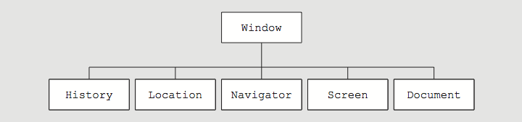
Understanding the Browser Object Model (cont’d.)
Figure 5-3 Browser object model
JavaScript, Sixth Edition

Slide 7
The Document Object Model
Document object
  Represents the Web page displayed in a browser
  Contains all Web page elements
  JavaScript represents each element by its own object
JavaScript, Sixth Edition

Slide 8
The DOM and DHTML
Dynamic HTML (DHTML)
  Interaction can change content of web page without reloading
  Can also change presentation of content
  Combination of HTML, CSS, and JavaScript
DOM
  example of an application programming interface (API)
  structure of objects with set of properties and methods
JavaScript, Sixth Edition

Slide 9
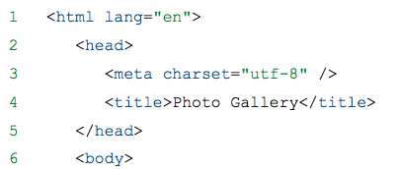
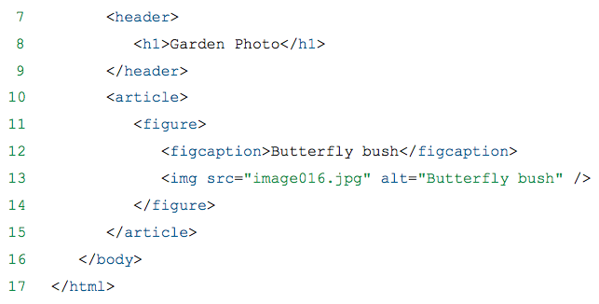
The DOM tree
The DOM hierarchy depends on a document's contents
JavaScript, Sixth Edition

Slide 10
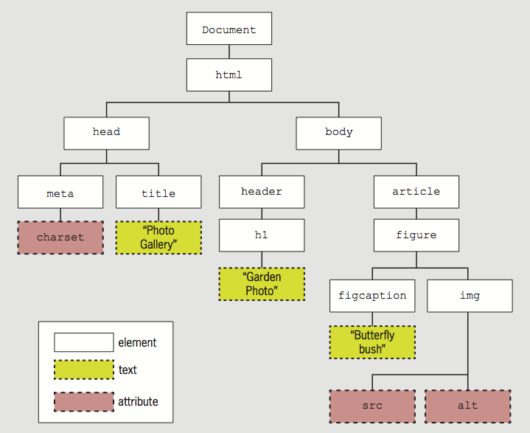
The DOM tree (cont'd.)
Figure 5-4 Example DOM tree
JavaScript, Sixth Edition

Slide 11
The DOM tree
Each item in the DOM tree is a node
Element, attribute, and text content nodes are most commonly used
JavaScript, Sixth Edition

Slide 12
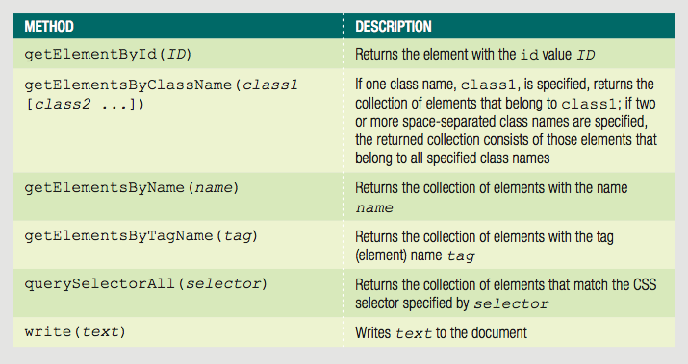
DOM Document Object Methods
Table 5-1 HTML DOM Document object methods
JavaScript, Sixth Edition

Slide 13
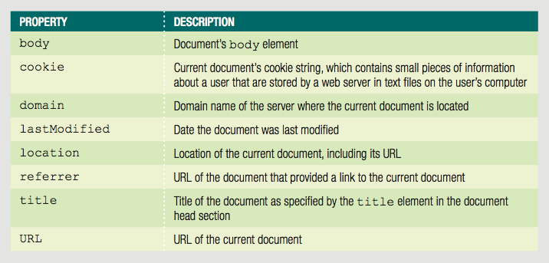
DOM Document Object Properties
Table 5-2 Selected DOM Document object properties
JavaScript, Sixth Edition

Slide 14
Accessing Document Elements, Content, Properties, and Attributes
Methods such as getElementById() are methods of the Document object
Several methods available for JavaScript to reference web page elements
JavaScript, Sixth Edition

Slide 15
Accessing Elements by id value
Set the id value in HTML
getElementById() method
  Returns the first element in a document with a matching id attribute
Example:
HTML element with id value
<input type="number" id="zip" />
JavaScript to reference HTML element
var zipField = document.getElementById("zip");
JavaScript, Sixth Edition

Slide 16
Accessing Elements by Tag Name
getElementsByTagName() method
  Returns array of elements matching a specified tag name
  Tag name is name of element
Method returns a set of elements
  Node list is indexed collection of nodes
  HTML collection is indexed collection of HTML elements
  Either set uses array syntax
JavaScript, Sixth Edition

Slide 17
Accessing Elements by Tag Name (cont'd.)
Example:
  Index numbers start at 0, so second element uses index number 1
  To work with the second h1 element on a page:
var secondH1 = document.getElementsByTagName("h1")[1];
JavaScript, Sixth Edition

Slide 18
Accessing Elements by Class Name
getElementsByClassName() method
  Returns node list or HTML collection of elements with a class attribute matching a specified value
Example
  All elements with class value side:
var sideElements = document.getElementsByClassName("side");
JavaScript, Sixth Edition

Slide 19
Accessing Elements by Class Name (cont'd.)
class attribute takes multiple values, so getElementsByClassName() method takes multiple arguments
Arguments enclosed in single set of quotes, with class names separated by spaces
Example
  All elements with class values side and green:
var sideGreenElements = document.getElementsByClassName("side green");
JavaScript, Sixth Edition

Slide 20
Accessing Elements by Name
getElementsByName() method
  Returns node list or HTML collection of elements with a name attribute matching a specified value
Not as useful as preceding options
  But creates more concise code when accessing set of option buttons or check boxes in a form:
Not standard in IE9 and earlier versions of IE, so important to test
var colorButtons = document.getElementsByName("color");
JavaScript, Sixth Edition

Slide 21
Accessing Elements with CSS Selectors
querySelector() method
  References elements using CSS syntax
  Returns first occurrence of element matching a CSS selector
Example:
HTML:
^{<header>}
<h1><img class="logo" src="images/logo.png"↵
alt="Blue Jay Photography" /></h1>
^{</header>}
JavaScript to reference img element
^{querySelector("header h1 img")}
JavaScript, Sixth Edition

Slide 22
Accessing Elements with CSS Selectors (cont'd)
IE8 supports only simple selectors
  Can use different approach in creating CSS selector
  Previous example could be rewritten as
^{querySelector("img.logo")}
JavaScript, Sixth Edition

Slide 23
Accessing Elements with CSS Selectors (cont'd)
querySelectorAll() method
  Returns collection of elements matching selector
  Different from querySelector() method, which returns only first occurrence
  Example:
HTML:
^{<nav>}
^{<ul>}
^{<li>About Us</li>}
^{<li>Order</li>}
^{<li>Support</li>}
^{</ul>}
^{</nav>}
JavaScript to reference all three li elements:
^{querySelectorAll("nav ul li")}
JavaScript, Sixth Edition

Slide 24
Accessing an Element's Content
textContent property
  Accesses and changes text that an element contains
  Unlike innerHTML, textContent strips out HTML tags
Example:
HTML:
^{<ul>}
<li class="topnav"><a href="aboutus.htm">About Us</a></li>
<li class="topnav"><a href="order.htm">Order</a></li>
<li class="topnav"><a href="support.htm">Support</a></li>
^{</ul>}
JavaScript to reference and access first li element:
var button1 = querySelectorAll("li.topNav")[0];
var allContent = button1.innerHTML;
// <a href="aboutus.htm">About Us</a>
var justText = button1.textContent;
^{// About Us}
JavaScript, Sixth Edition

Slide 25
Accessing an Element's Content (cont'd)
textContent property is more secure
  Not supported by IE8 or earlier
  Some developers use if/else construction to implement textContent only on supported browsers
JavaScript, Sixth Edition

Slide 26
Accessing an Element's CSS Properties
Can access CSS properties through DOM
  Use dot notation
  Reference element's style property followed by name of CSS property
  Example: change value of CSS display property to none for element with id value logo:
document.getElementById("logo").style.display = "none";
JavaScript, Sixth Edition

Slide 27
Accessing an Element's CSS Properties (cont'd.)
When CSS property includes hyphen (-), remove hyphen and capitalize letter following hyphen
  Use dot notation
  font-family becomes fontFamily
  Example:
CSS value specified using DOM reference is an inline style
  Higher priority than embedded or external styles
var font = document.getElementById("logo").style.fontFamily;
JavaScript, Sixth Edition

Slide 28
Accessing an Element's CSS Properties (cont'd.)
To remove a style you previously added with a DOM reference
  set its value to an empty string
  Example:
document.getElementById("navbar").style.color = "";
JavaScript, Sixth Edition

Slide 29
Accessing Element Attributes
Access element attribute with period and name of attribute after element reference
  Reference element with id value homeLink:
  Reference href attribute of same element:
Can use to look up attribute value and assign to variable, or to assign new value to attribute
document.getElementById("homeLink")
document.getElementById("homeLink").href
JavaScript, Sixth Edition

Slide 30
Accessing Element Attributes (cont'd)
One exception for accessing element attributes
  Must use property name className to refer to class attribute values
  Single class value returned like standard attribute value
  Multiple class values returned in single string, separated by spaces
JavaScript, Sixth Edition

Slide 31
Adding and Removing Document Nodes
DOM includes methods to change DOM tree
  Can create brand new elements
  Can add/remove elements from DOM tree
JavaScript, Sixth Edition

Slide 32
Creating Nodes
createElement() method
  Creates a new element
  Syntax:
  element is an element name
  Example:
    To create a new div element:
document.createElement("element")
^{document.createElement("div");}
JavaScript, Sixth Edition

Slide 33
Attaching Nodes
Newly created node is independent of DOM tree
appendChild() method
  Attaches node to DOM tree
  Syntax:
  childNode is node to be attached
  parentNode is node to attach child node to
parentNode.appendChild(childNode)
JavaScript, Sixth Edition

Slide 34
Attaching Nodes (cont'd.)
Example:
  Create new li element and attach to element with id value navList:
Document fragment
  Set of connected nodes not part of document
  Can use appendChild() to add document fragment to DOM tree for a document
var list = document.getElementById("navList");
var contact = document.createElement("li");
^{list.appendChild(contact);}
JavaScript, Sixth Edition

Slide 35
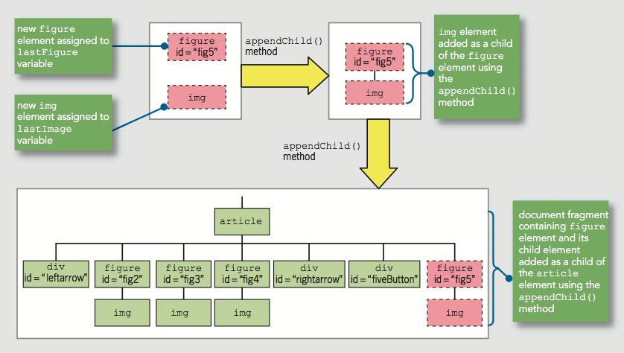
Attaching Nodes (cont'd.)
Table 5-7 Using the appendChild() method to attach nodes
JavaScript, Sixth Edition

Slide 36
Cloning Nodes
Create new node same as existing node
cloneNode() method
Syntax:
  existingNode.cloneNode(true | false)
  true argument clones child nodes
  false argument clones only specified parent node
Example:
^{document.createElement("div");}
JavaScript, Sixth Edition

Slide 37
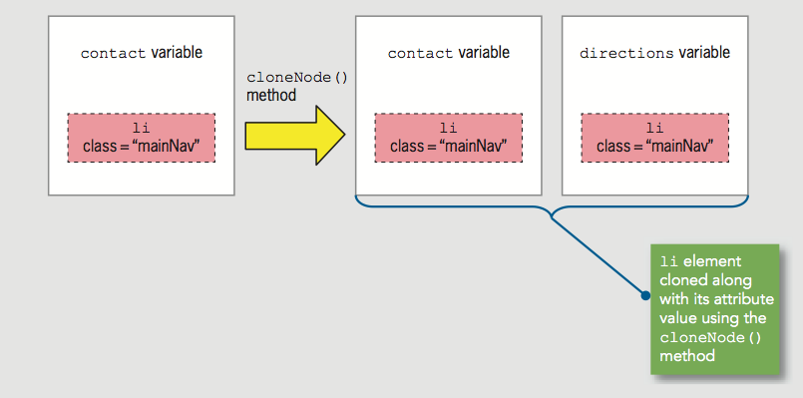
Cloning Nodes (cont'd.)
Example:
var contact = document.createElement("li");
^{contact.className = "mainNav";}
var directions = contact.cloneNode(true);
Figure 5-10 Using the cloneNode() method
JavaScript, Sixth Edition

Slide 38
Inserting Nodes at Specific Positions in the Document Tree
New node created with createElement() is not attached to document tree
appendChild() adds node after existing child nodes
To specify a different position, use insertBefore()
Syntax:
  parentNode.insertBefore(newChildNode, existingChildNode)
JavaScript, Sixth Edition

Slide 39
Inserting Nodes at Specific Positions in the Document Tree (cont'd.)
Example:
  HTML:
  JavaScript:
^{<ul id="topnav">}
<li><a href="aboutus.htm">About Us</a></li>
<li><a href="order.htm">Order</a></li>
<li><a href="support.htm">Support</a></li>
^{</ul>}
var list = document.getElementById("topnav");
var directions = document.createElement("li");
directions.innerHTML = "Directions";
var aboutus = document.querySelectorAll("#topnav li")[0];
list.insertBefore(directions, aboutus);
JavaScript, Sixth Edition

Slide 40
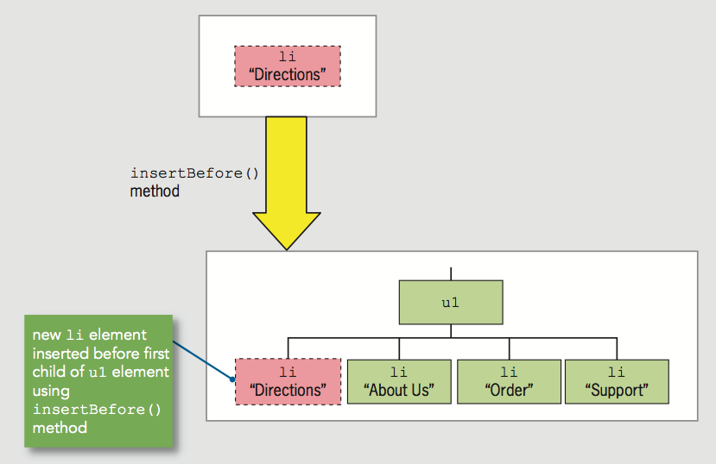
Inserting Nodes at Specific Positions in the Document Tree (cont'd.)
Figure 5-14 Using the insertBefore() method
JavaScript, Sixth Edition

Slide 41
Removing Nodes
removeNode() removes node from DOM tree
Syntax:
  parentNode.removeChild(childNode)
Can assign removed node to variable:
  Node removed without being assigned to a variable is deleted during garbage collection
var list = document.getElementById("topnav");
var aboutus = document.querySelectorAll("#topnav li")[0];
var aboutNode = list.removeChild(aboutus);
JavaScript, Sixth Edition

Slide 42
Manipulating the Browser with the Window Object
Window object
  Includes properties containing information about the web browser window or tab
  Contains methods to manipulate the web browser window or tab itself
JavaScript, Sixth Edition

Slide 43
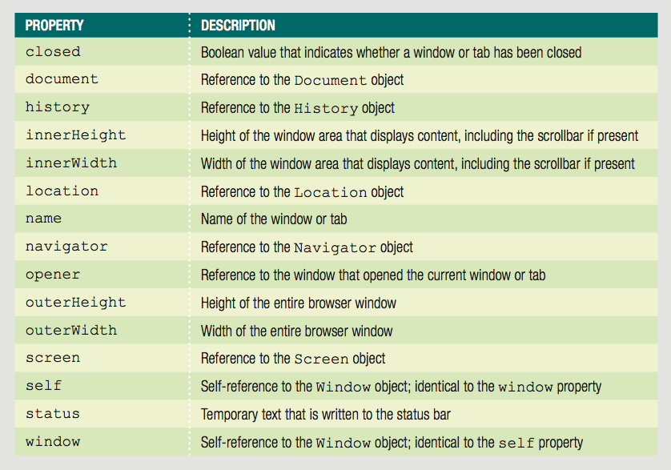
Manipulating the Browser with the Window Object (cont’d.)
Table 5-3 Window object properties
JavaScript, Sixth Edition

Slide 44
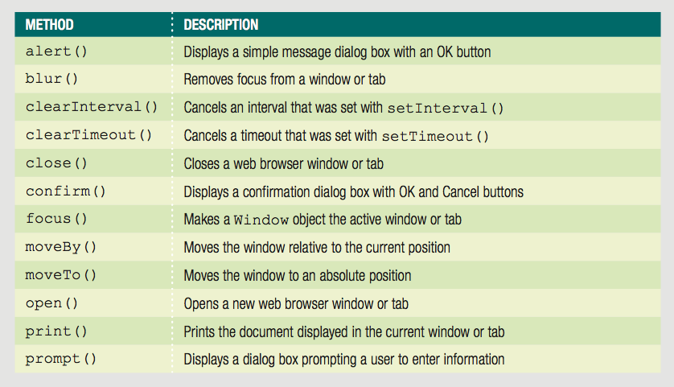
Manipulating the Browser with the Window Object (cont’d.)
Table 5-4 Window object methods (continues)
JavaScript, Sixth Edition

Slide 45
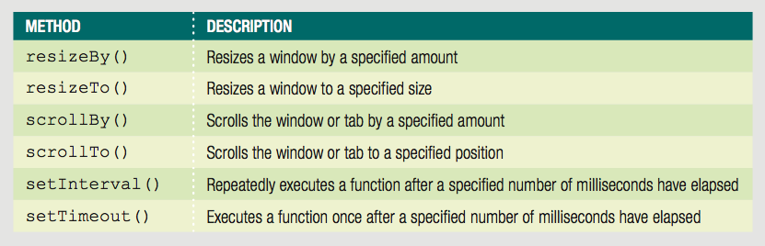
Manipulating the Browser with the Window Object (cont’d.)
Table 5-4 Window object methods
JavaScript, Sixth Edition

Slide 46
Manipulating the Browser with the Window Object (cont’d.)
self property
  Refers to the current Window object
  Identical to using the window property to refer to the Window object
  Examples:
    ^{window.close();}
    ^{self.close();}
Web browser assumes reference to global object
Good practice
  Use window or self references
    When referring to a Window object property or method
JavaScript, Sixth Edition

Slide 47
Opening and Closing Windows
Reasons to open a new Web browser window
  To launch a new Web page in a separate window
  To use an additional window to display information
When new Web browser window opened:
  New Window object created
    Represents the new window
Know how to open a link in a new window using the a element’s target attribute
<a href="http://www.wikipedia.org/"↵
target="wikiWindow">Wikipedia home page</a>
JavaScript, Sixth Edition

Slide 48
Opening a Window
open() method of the Window object
  Opens new windows
Syntax
  window.open(url, name, options, replace);
Table 5-5 Arguments of the Window object’s open() method
JavaScript, Sixth Edition

Slide 49
Opening a Window (cont’d.)
Include all (or none) window.open() method arguments
Example:
  window.open("http://www.wikipedia.org");
JavaScript, Sixth Edition

Slide 50
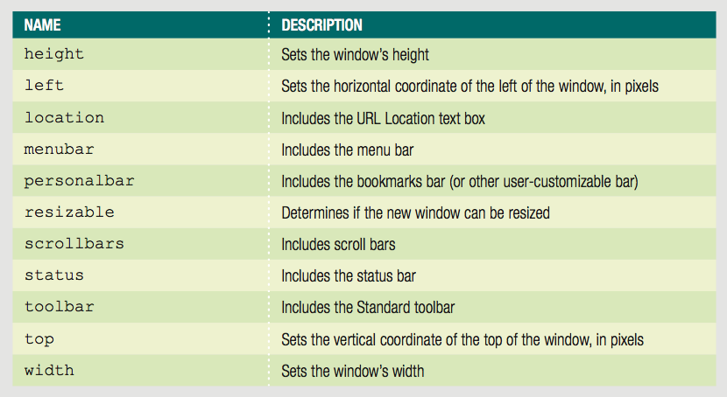
Opening a Window (cont’d.)
Customize new browser window or tab appearance
  Use window.open() method options argument
Table 5-6 Common options of the Window object’s open() method
JavaScript, Sixth Edition

Slide 51
Opening a Window (cont’d.)
window.open() method name argument
  Same as value assigned to the target attribute
    Specifies window name where the URL should open
  If name argument already in use
    JavaScript changes focus to the existing Web browser window instead of creating a new window
JavaScript, Sixth Edition

Slide 52
Opening a Window (cont’d.)
Window object’s name property used to specify a target window with a link
  Cannot be used in JavaScript code
Assign the new Window object created with the window.open() method to a variable to control it
focus() method
  Makes a window the active window
JavaScript, Sixth Edition

Slide 53
Closing a Window
close() method
  Closes a web browser window
window.close() or self.close()
  Closes the current window
JavaScript, Sixth Edition

Slide 54
Working with Timeouts and Intervals
Window object’s timeout and interval methods
  Creates code that executes automatically
setTimeout() method
  Executes code after a specific amount of time
  Executes only once
  Syntax
    var variable = setTimeout("code", milliseconds);
clearTimeout() method
  Cancel setTimeout() before its code executes
Example on next slide
JavaScript, Sixth Edition

Slide 55
Working with Timeouts and Intervals (cont’d.)
var buttonNotPressed = setTimeout("window.alert('Your↵
changes have been saved')",10000);
^{function buttonPressed() {}
clearTimeout(buttonNotPressed);
^{window.open(index.htm);}
}
JavaScript, Sixth Edition

Slide 56
Working with Timeouts and Intervals (cont’d.)
setInterval() method
  Repeatedly executes the same code after being called only once
  Syntax:
    var variable = setInterval("code", milliseconds);
clearInterval() method
  Used to clear setInterval() method call
JavaScript, Sixth Edition

Slide 57
The History Object
History object
  Maintains internal list (history list)
    All documents opened during current web browser session
Security features
  Will not display URLs contained in the history list
JavaScript, Sixth Edition

Slide 58
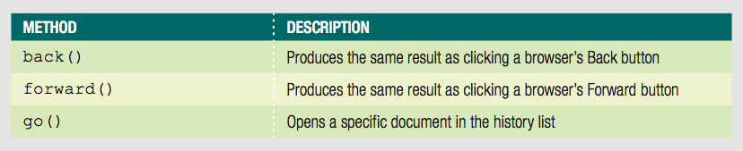
The History Object (cont’d.)
Table 5-7 Methods of the History object
JavaScript, Sixth Edition

Slide 59
The History Object (cont’d.)
go() method
  Allows navigation to a specific previously visited web page
History object length property
  Provides specific number of documents opened during the current browser session
  Example:
    Return to first document opened in current browser session:
    history.go(-(history.length - 1));
JavaScript, Sixth Edition

Slide 60
The Location Object
Location object
  Allows changes to a new web page from within JavaScript code
Location object properties allow modification of URL individual portions
  Web browser automatically attempts to open that new URL
JavaScript, Sixth Edition

Slide 61
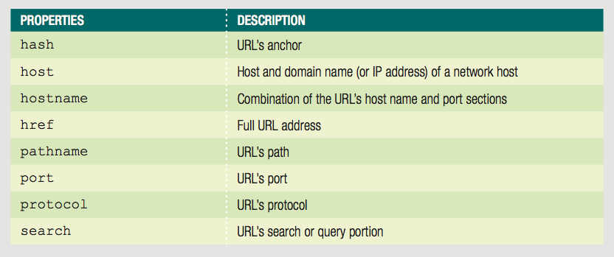
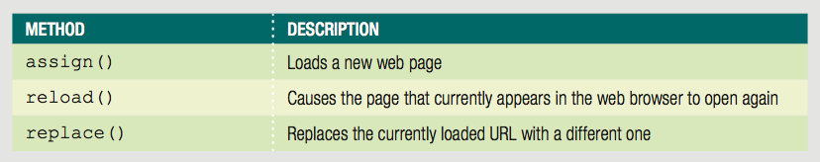
The Location Object (cont’d.)
Table 5-8 Properties of the Location object
Table 5-9 Methods of the Location object
JavaScript, Sixth Edition

Slide 62
The Location Object (cont’d.)
Location object’s assign() method
  Same action as changing the href property
  Loads a new web page
Location object’s reload() method
  Equivalent to the browser Reload or Refresh button
  Causes current page to open again
Location object’s replace() method
  Replaces currently loaded URL with a different one
JavaScript, Sixth Edition

Slide 63
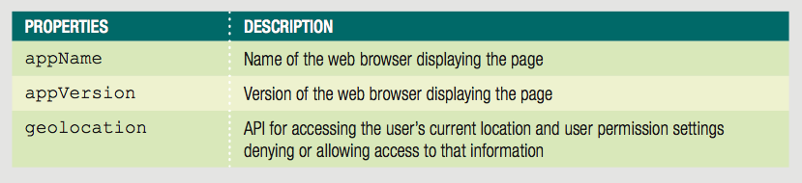
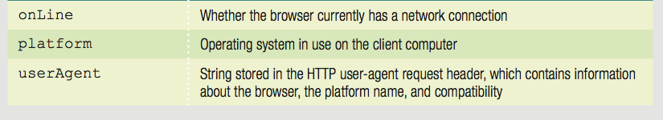
The Navigator Object
Navigator object
  Obtains information about current web browser
  Example: determine type of web browser running
Table 5-10 Properties of the Navigator object
JavaScript, Sixth Edition

Slide 64
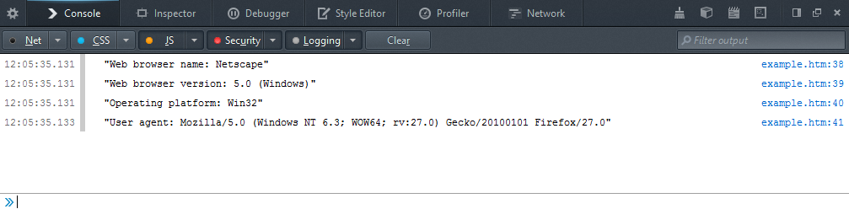
The Navigator Object (cont’d.)
console.log("Web browser name: " + navigator.appName);
console.log("Web browser version: " + navigator.appVersion);
console.log("Operating platform: " + navigator.platform);
console.log("User agent: " + navigator.userAgent);
Figure 5-19 Navigator object properties in Firefox console
JavaScript, Sixth Edition

Slide 65
The Screen Object
Screen object
  Obtains information about display screen’s size, resolution, color depth
Common use of Screen object properties
  Centering a web browser window in the middle of the display area
JavaScript, Sixth Edition

Slide 66
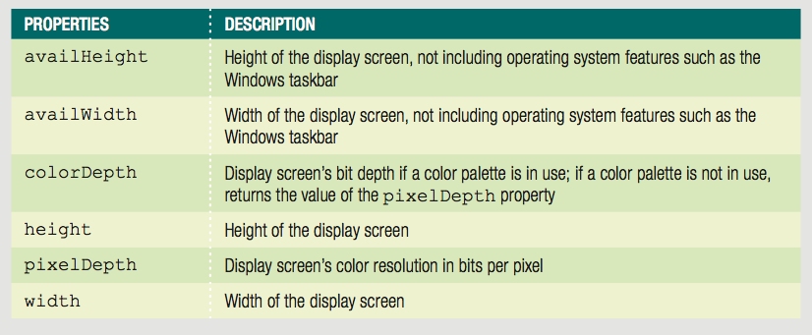
The Screen Object (cont’d.)
Table 5-11 Properties of the Screen object
JavaScript, Sixth Edition

Slide 67
The Screen Object (cont’d.)
Common Screen object properties uses
  Center a web browser window
  Example:
^{var winWidth = 300;}
^{var winHeight = 200;}
var leftPosition = (screen.width - winWidth) / 2;
var topPosition = (screen.height - winHeight) / 2;
var optionString = "width=" + winWidth + ",height="↵
+ winHeight + ",left=" + leftPosition + ",top="↵
^{+ topPosition;}
var openWin = window.open("", "CtrlWindow", optionString);
JavaScript, Sixth Edition

Slide 68
Summary
Browser object model (BOM) or client-side object model
  Hierarchy of objects
Top-level object in the browser object model
  Window object
Document object: most important object
DOM represents web page displayed in window
JavaScript, Sixth Edition

Slide 69
Summary (cont'd.)
Access elements with getElementById(), getElementsByTagName(), getElementsByClassName(), getElementsByName, querySelector(), or querySelectorAll()
Access element content with textContent() or innerHTML() property
Access CSS properties using an element's JavaScript style property
JavaScript, Sixth Edition

Slide 70
Summary (cont'd.)
Create new node with createElement()
Attach node with appendChild()
Clone node with cloneNode()
Attach node in specific place with insertBefore()
Remove node with removeNode()
Open new window with window.open()
Close window with window.close()
JavaScript, Sixth Edition

Slide 71
Summary (cont'd.)
setTimeout() executes code after specific amount of time
clearTimeout() cancels setTimeout()
setInterval() executes code repeatedly
clearInterval() cancels setInterval()
JavaScript, Sixth Edition

Slide 72
Summary (cont’d.)
History object maintains an opened documents history list
Location object allows changes to a new web page from within JavaScript code
Navigator object obtains information about the current web browser
Screen object obtains information about the display screen’s size, resolution, color depth
JavaScript, Sixth Edition

